Slide 1
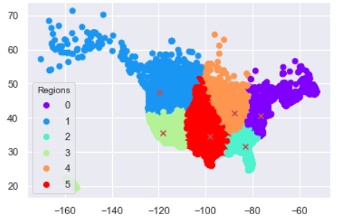
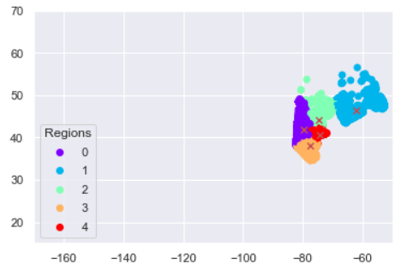
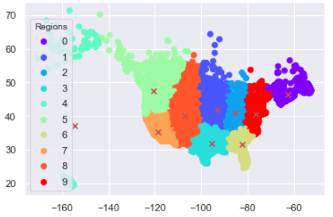
Region Clustering
Weighted KMeans:
K-means algorithm identifies k number of centroids, and then allocates every data point to the nearest cluster. In a weighted KMeans, every observation has a corresponding weight due to which centroid shifts towards the observations with more weights
6 Region Clustering
Sub-Regions for Region 0
Sub- Regions | Sales | Zips
0 | 138150 | 27024
1 | 9723 | 6015
2 | 49123 | 14113
3 | 188434 | 2204
4 | 228434 | 1646
Total | 613864 | 51002
Region | Sales | Zips
0 | 613864 | 51002
1 | 112275 | 19122
2 | 344824 | 4555
3 | 335473 | 2951
4 | 446749 | 12167
5 | 289867 | 6281
Total | 2143052 | 96078
10 Region Clustering
Region | Sales | Zips
0 | 10102 | 6214
1 | 174179 | 7228
2 | 355641 | 10073
3 | 212255 | 3811
4 | 3666 | 189
5 | 101818 | 17216
6 | 316602 | 3807
7 | 312833 | 2406
8 | 88249 | 3656
9 | 567707 | 41478
Total | 2143052 | 96078

